Slide 1
Sexism in the workplace? We have come a long way
Joanne Harrison-Gross
22nd May, 2022

Slide 2
Agenda
A quick CV
Some anecdotes
Cultural differences
Why do we need to market?
Experience with current employer
Learnings from an MBA
Couples that work
Let´s discuss

Slide 3
A quick CV
St. John´s College, 1981
Postgraduate diploma, Canterbury University
British Nuclear Fuels plc
Mercedes-Benz, Stuttgart
Master of Business Administration, Insead
General Motors Europe
BNP Paribas

Slide 4


Some anecdotes
School & St. John´s
British Nuclear Fuels

Slide 5
Cultural differences
Mercedes-Benz
  „Die Damen“
General Motors
  The American influence
Scandinavia
France

Slide 6
Why do we need to market?
Positioning, promise, expectation & delivery
Products don´t sell themselves – however great the USP‘s
Designers & engineers don´t necessarily know how to sell the customer benefits
The four P´s: product, place, promotion, price

Slide 7





Memorable brands

Slide 8
Self-marketing: making the most of yourself
What are your USP‘s?
Make up your elevator pitch
Think what you represent – you´re a great scientist and more!
Brand Me

Slide 9





Clichees happen quickly.
Be & take care of yourself

Slide 10
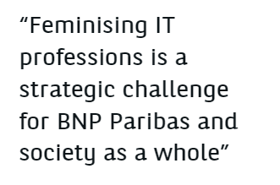

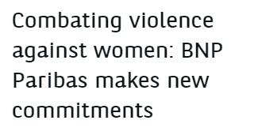
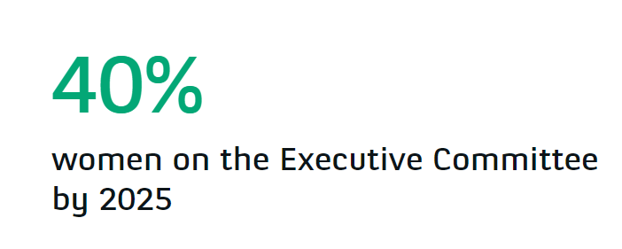
My current employer
JamaisSansElles

Slide 11
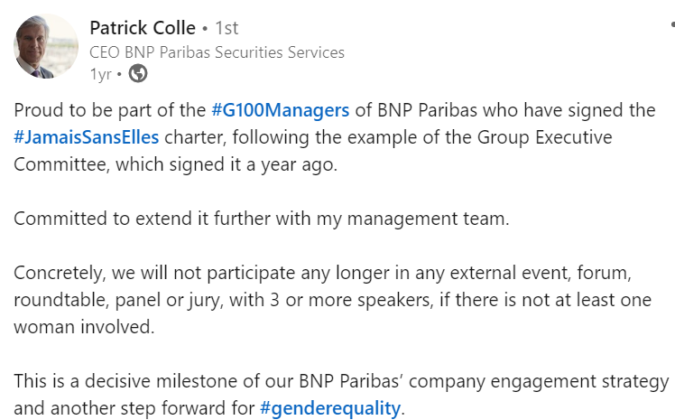
BNP Paribas

Slide 12
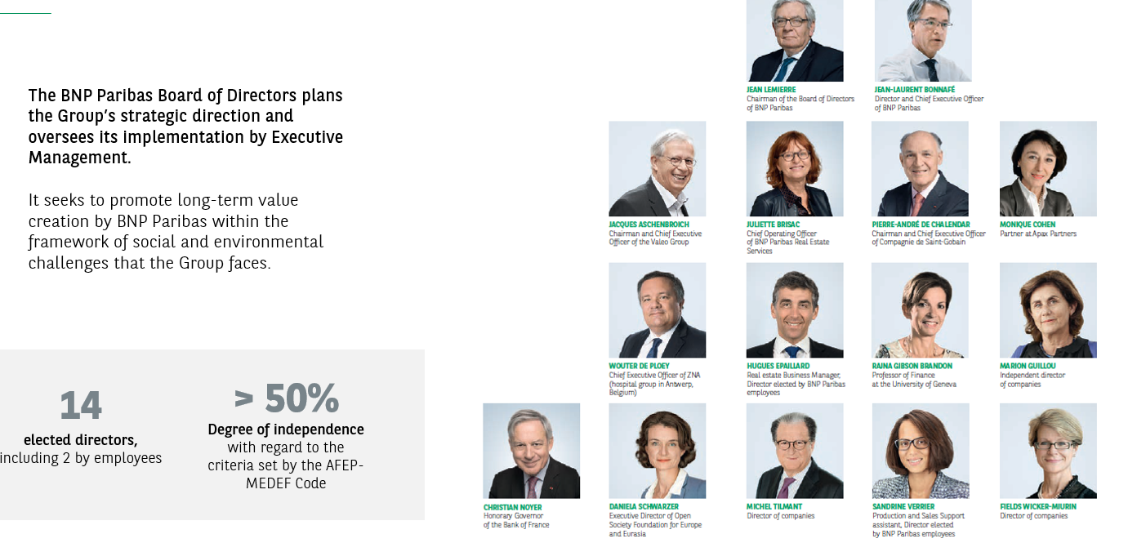
BNP Paribas Board of Directors balance

Slide 13
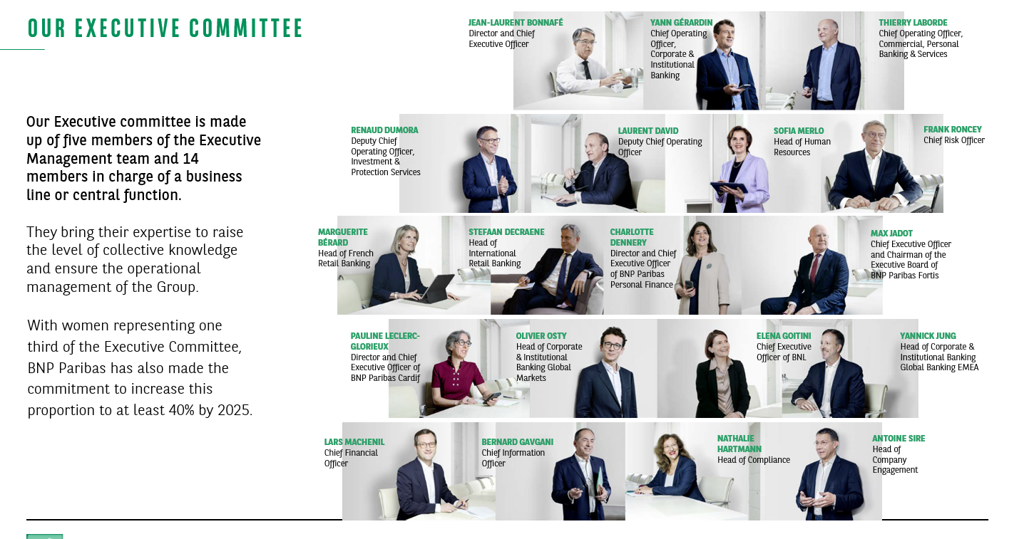
Our Executive Committee

Slide 14
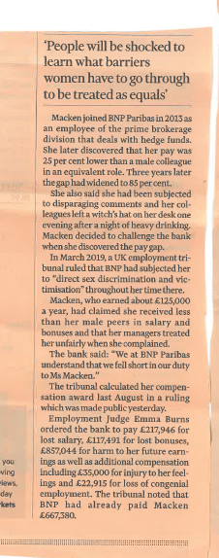
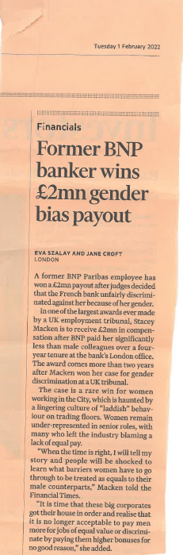
No one is perfect

Slide 15

Learnings from an MBA
Don´t always gravitate to what you do easiest
Feel comfortable with numbers, balance sheets, presenting figures
Don´t be overly sensitive in groups
Take a negotiation course
Practice presenting

Slide 16
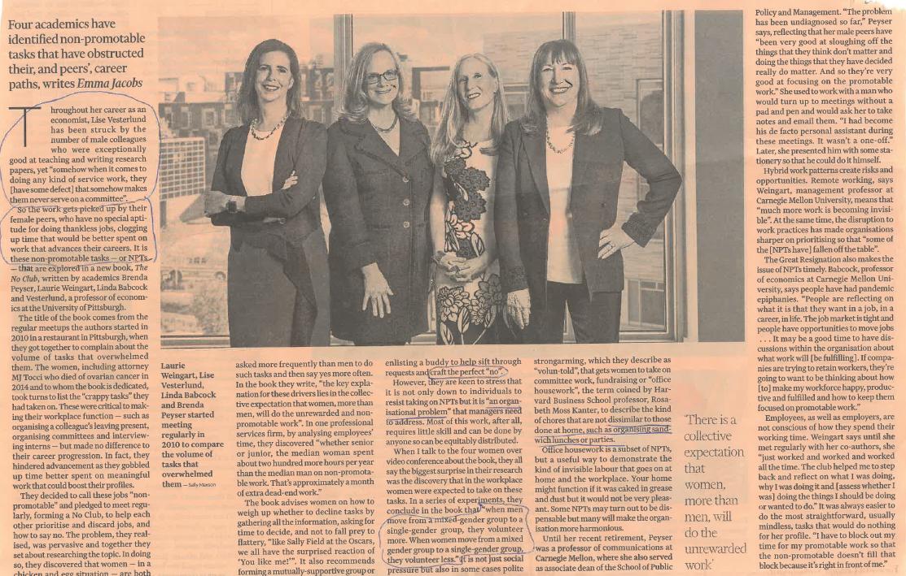
„Learing how to say „no“ to office housework: FT article

Slide 17

Further reflections
The role of sport/extracurricular competence
Say yes to new challenges

Slide 18

Couples that work
Pick your partner well
  Sheryl Sandberg „The most
  important career decision you
  will make is who you marry“
The role of children
Pick your employer well

Slide 19
Let´s discuss!

